Slide 1
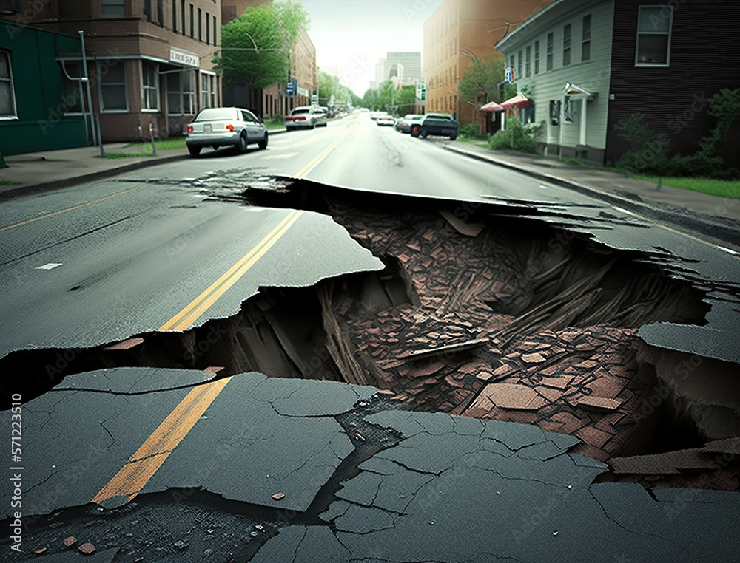
Global Significant Earthquake Database from 2150BC

Slide 2
In this project, we will check Q1. Where are the earthquakes? Are they located on the Pacific Ring of Fire? Q2. When do earthquakes occur? Investigating the number of earthquake trends over time Q3. How often do earthquakes trigger tsunamis? Q4. What is the correlation between Magnitude and Intensity?

Slide 3
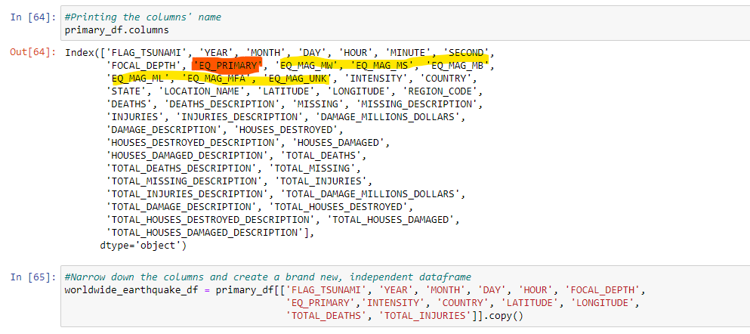
Exploring and cleaning the Data:
Data contains several different types of earthquake measurements - summarized by one column. The others were removed
Handling null values:
we narrowed down the number of columns that have the greatest number of null values
we left some of them, because of the nature of the data
we used, the dropna() function in the code

Slide 4
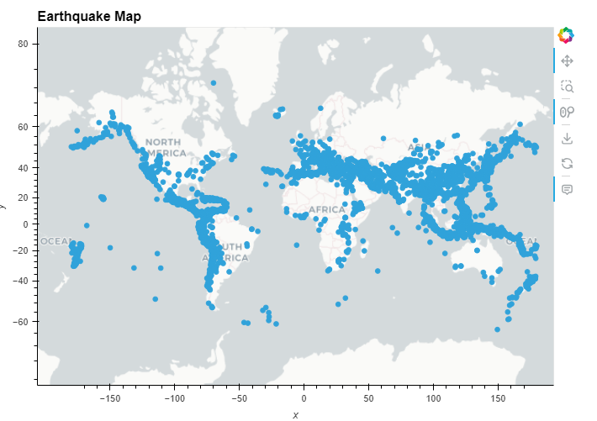
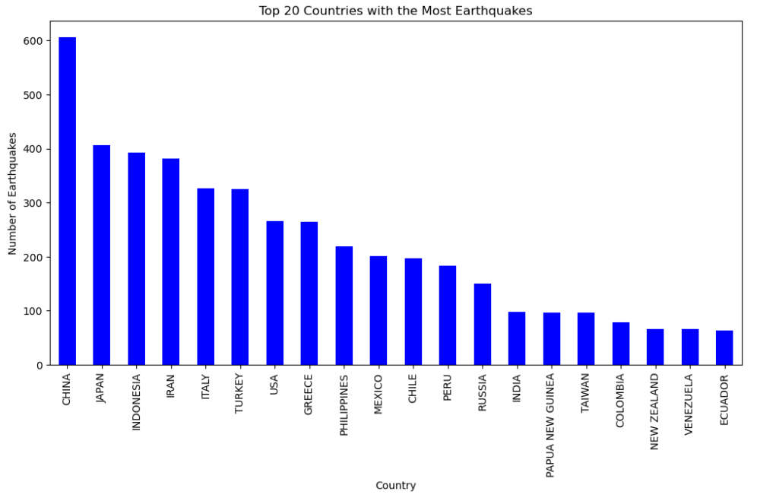
Q1. Where are the earthquakes: geographic distribution
Plot interactive map using latitude and longitude
Which countries have the most earthquake
This interactive map provides a direct view of individual earthquake locations and other information

Slide 5
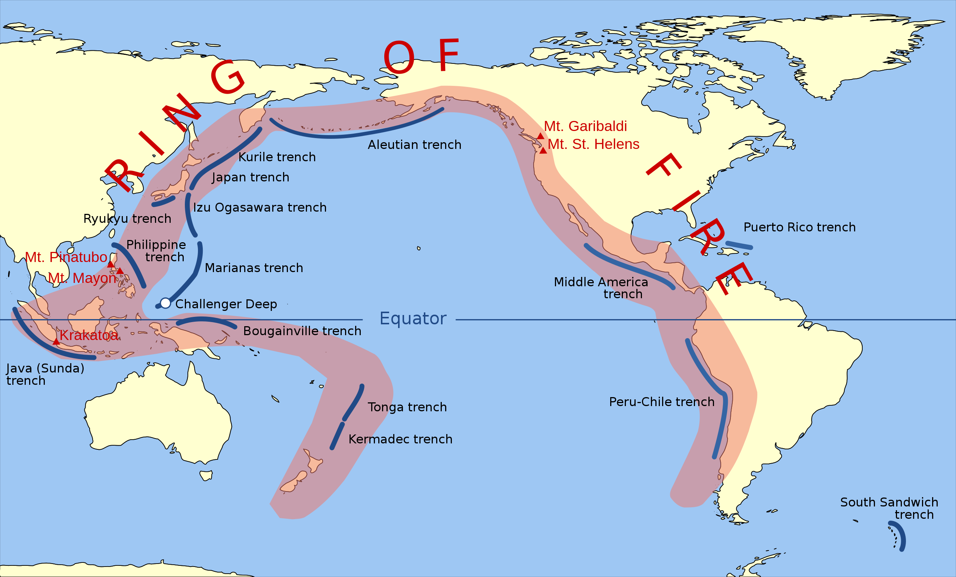
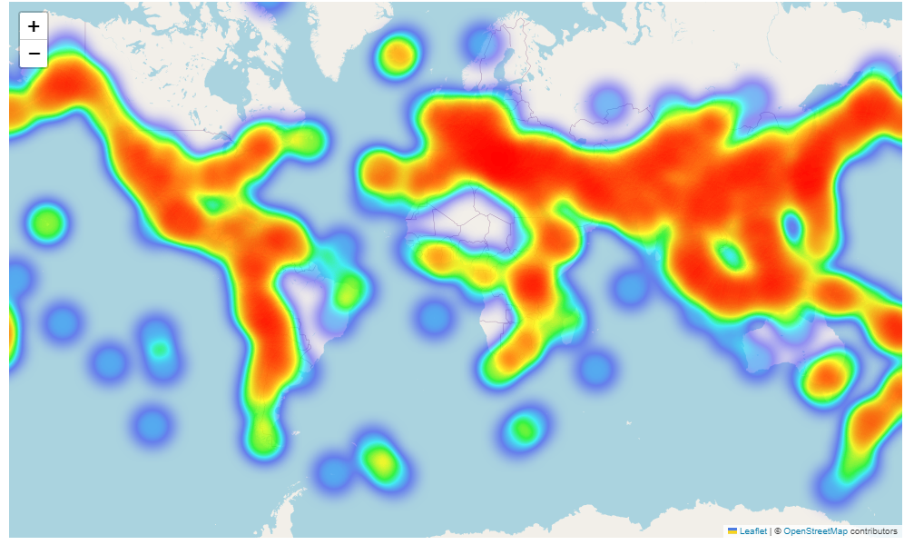
Q1. Where are the earthquakes: geographic distribution
Discussion of results:
Are they where you expect them to be?
Mostly yes, they correspond to the ring of fire (edges of tectonic plates). But some outliers e.g. in Australia
Plot heatmap using latitude and longitude
(to visualise areas with higher seismic activity)

Slide 6
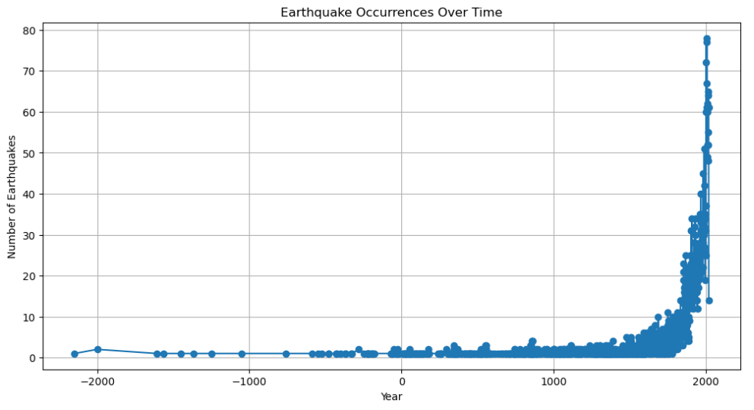
Q2. When do earthquakes occur?
Plot scatter plot showing all earthquakes across time using magnitude
Discussion of results
Big bias in data – as discussed earlier, no instruments were available to measure earthquake magnitude in historic data

Slide 7
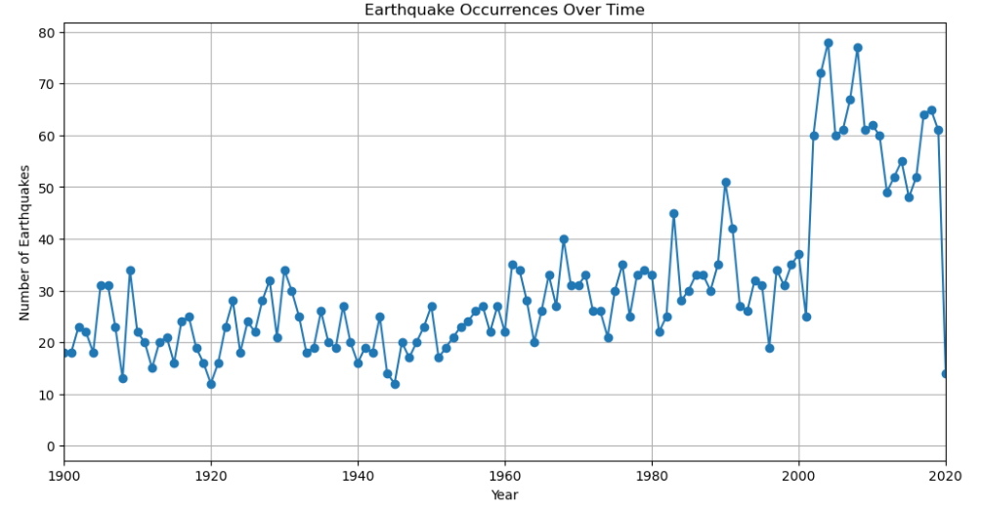
Q2. When do earthquakes occur?
If limit data to from 1900 onwards, remove that bias
(seismometers were invented in 1875)

Slide 8
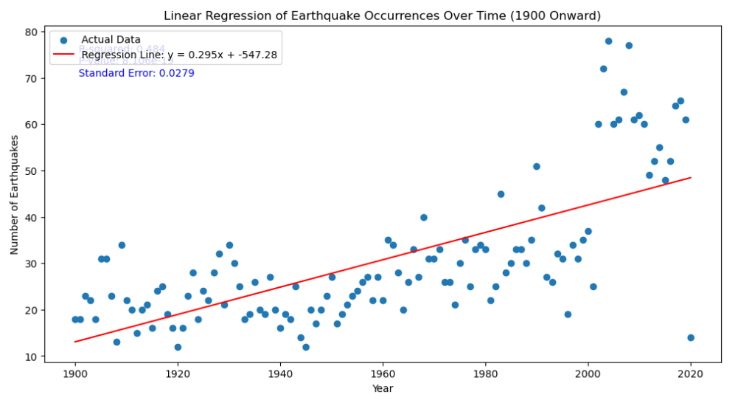
Q2. When do earthquakes occur?
Linear correlation suggests earthquakes increase with time
Discussion of results
Possibly still due to increasing global measurements of earthquakes over time
Interesting data, but earthquakes work on geological time scales (millions of years), so it may not be statistically significant to look at the last 100 years

Slide 9
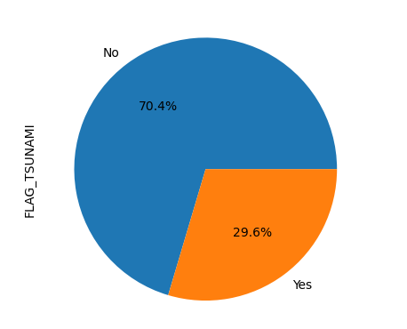
Q3. How often do earthquakes trigger tsunamis?
Discussion of results
Most earthquakes did not result in a tsunami

Slide 10
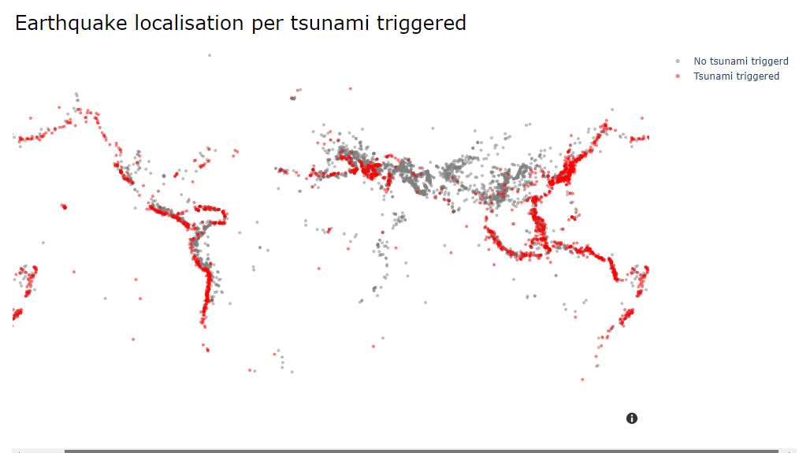
Q3. How often do earthquakes trigger tsunamis?
Discussion of results
Earthquakes that occur offshore or near the coast are more likely to trigger tsunamis and those on land
Not all earthquakes offshore trigger tsunamis

Slide 11
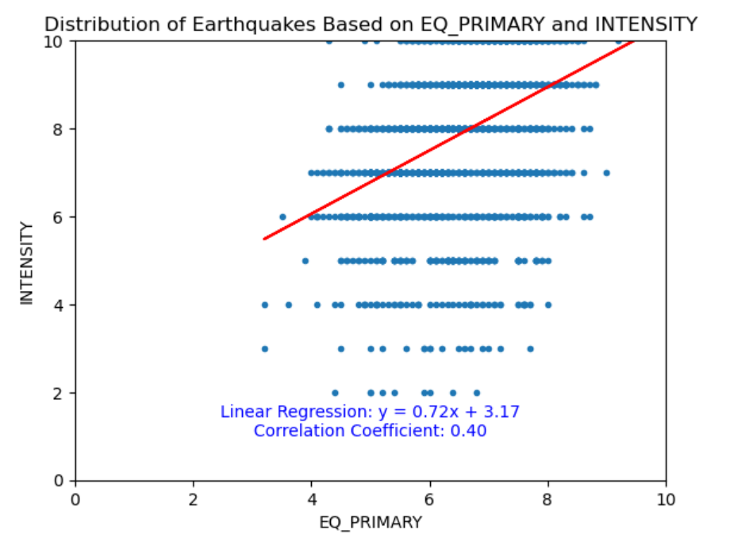
Q4. What is the correlation between Magnitude and Intensity?
Discussion of results:
Limitations in the data.
Earthquakes can be measured by MAGNITUDE (Quantitative values – need modern instruments) OR by INTENSITY (qualitative description).
A lot of historic earthquakes don’t have a MAGNITUDE value, so the graph is biased toward modern earthquakes
Only Whole numbers are used for Intensity, so it makes the data look artificial

Slide 12
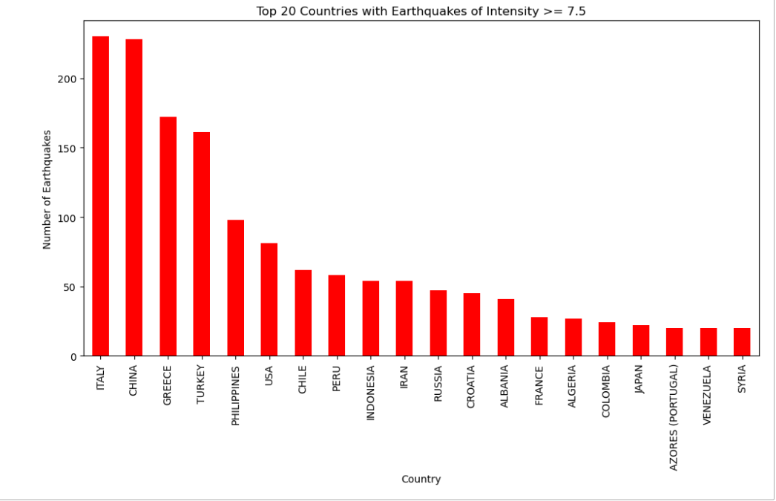
Q4. What is the correlation between Magnitude and Intensity?
Plot which countries have the most earthquakes by intensity >7.5 instead of magnitude
Discussion of results:
Changes the top country – now Italy has the greatest number of earthquakes, most likely due to good documentation by the Ancient Roman Empire
Biases the data towards historic earthquakes (possibly)

